Slide 1

Project 1 Consultancy Management App
By Michael McColl

Slide 2
Presentation Structure
Brief Motivation
Project Planning
Design
Development
Live Demonstration
Testing
Code Highlights
Learning Points

Slide 3
Brief Motivation
Previously worked for a Big 4 consultancy
Last few years have worked as an independent consultant
Wanted to build a business-to-customer app, supplemented with service offerings
Sought a brief that I could potentially utilise in real life
Aimed to stretch myself, by trying to implement the subjects taught so far

Slide 4
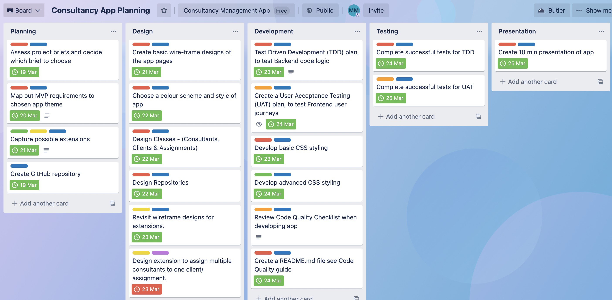
Project Planning

Slide 5
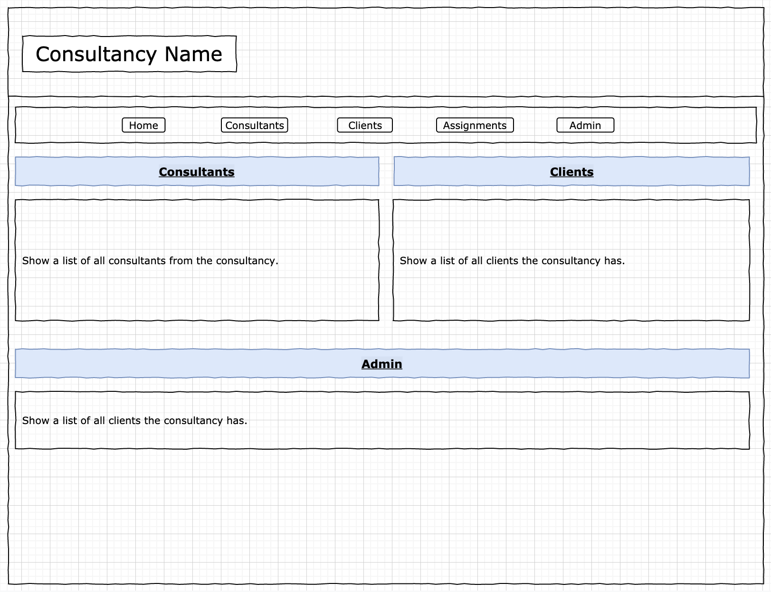
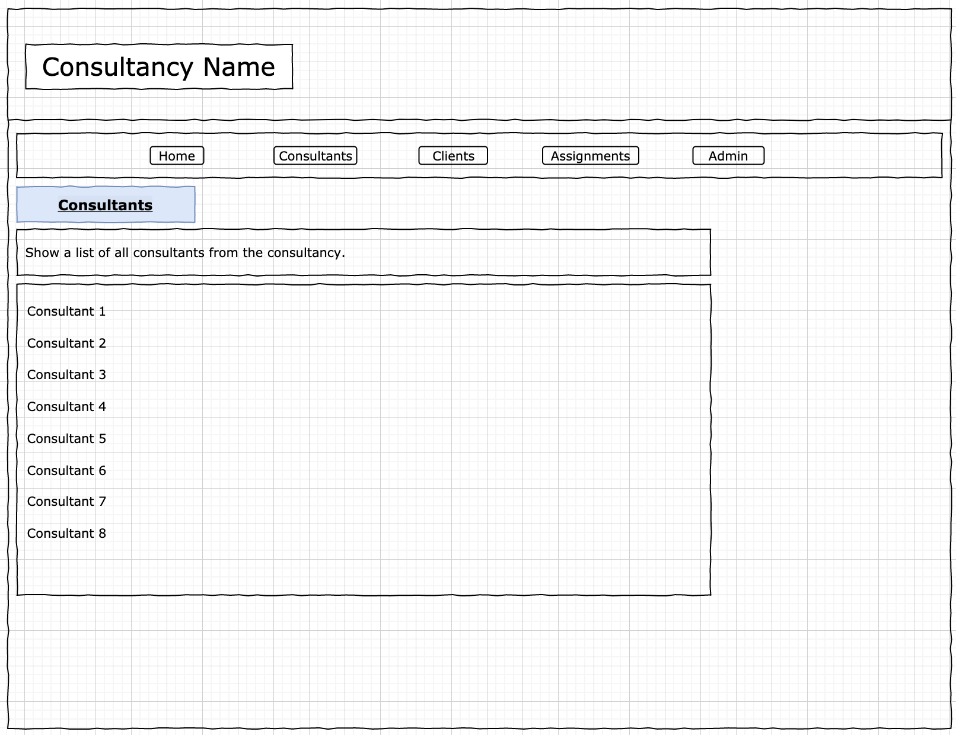
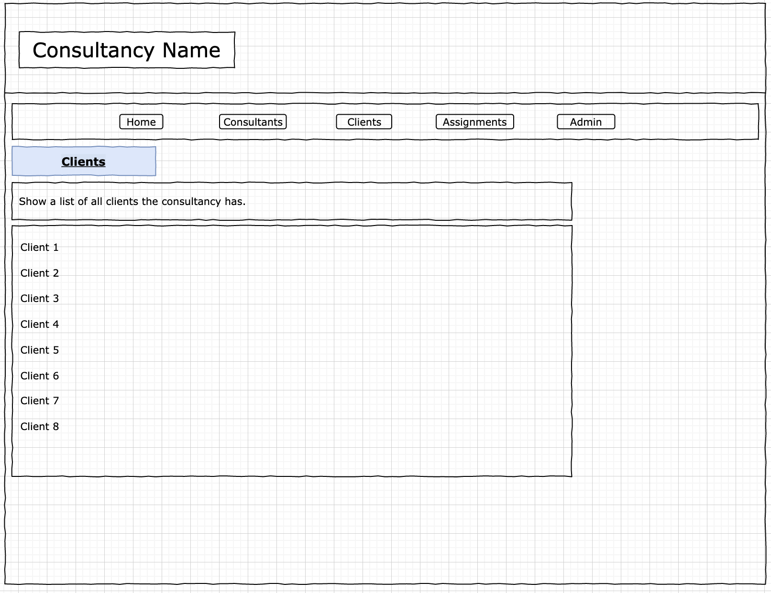
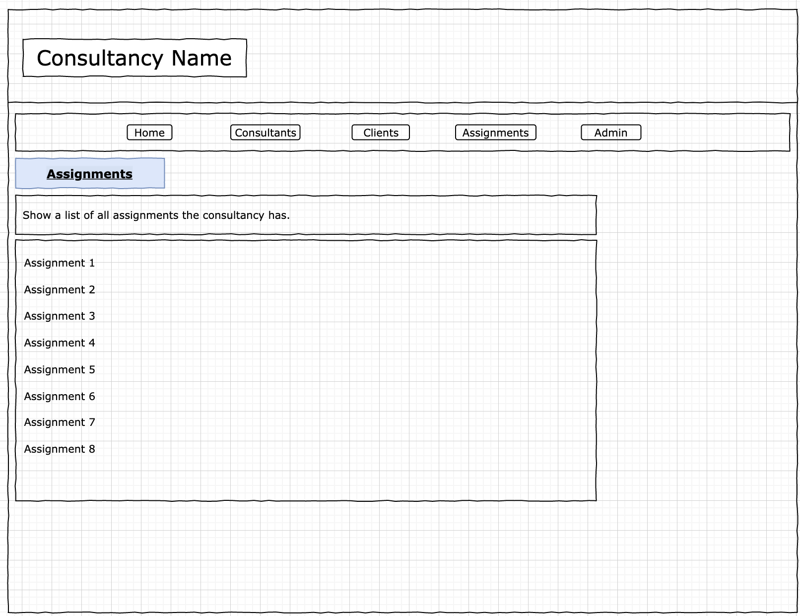
Design - Wireframes

Slide 6
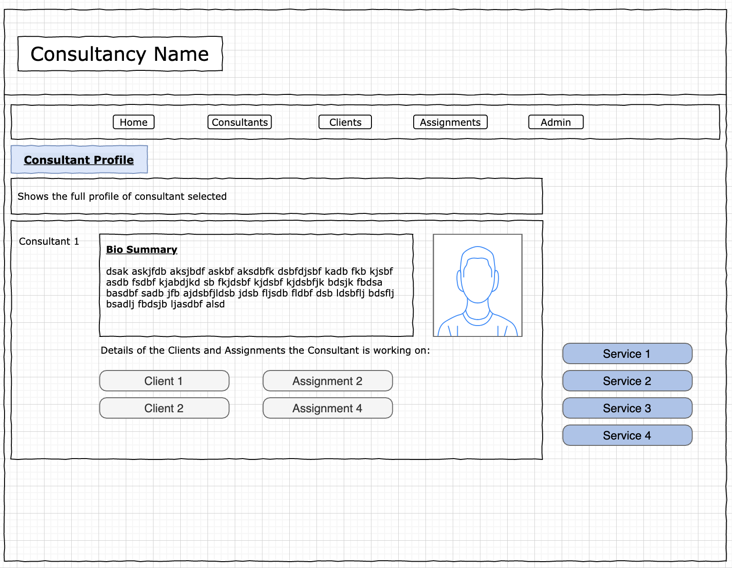
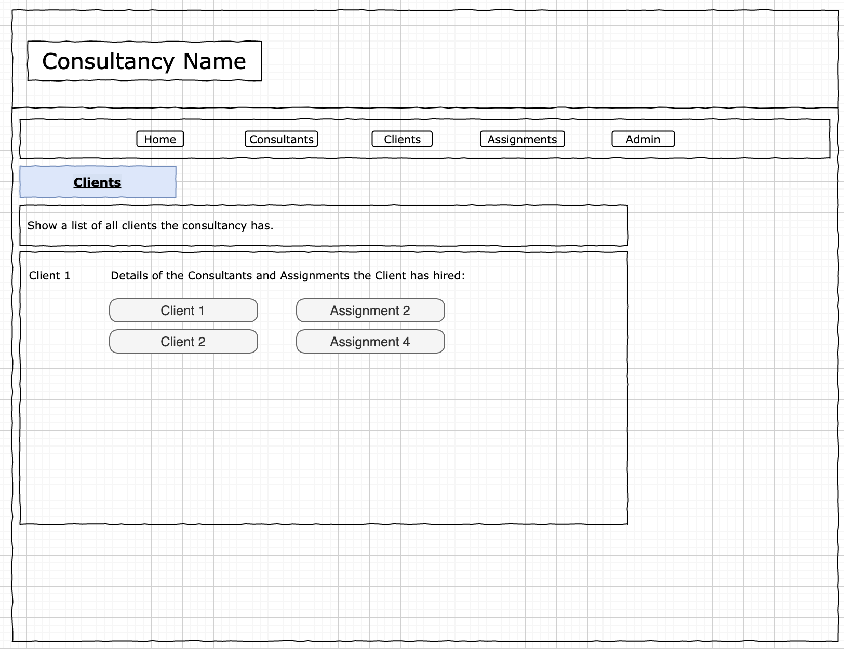
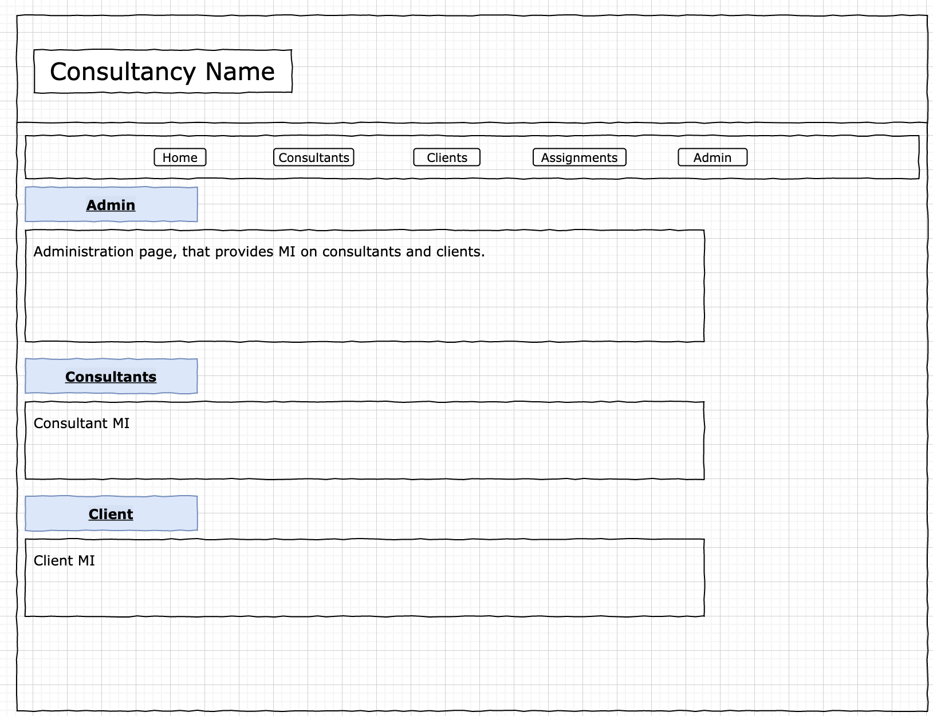
Design - Wireframes

Slide 7
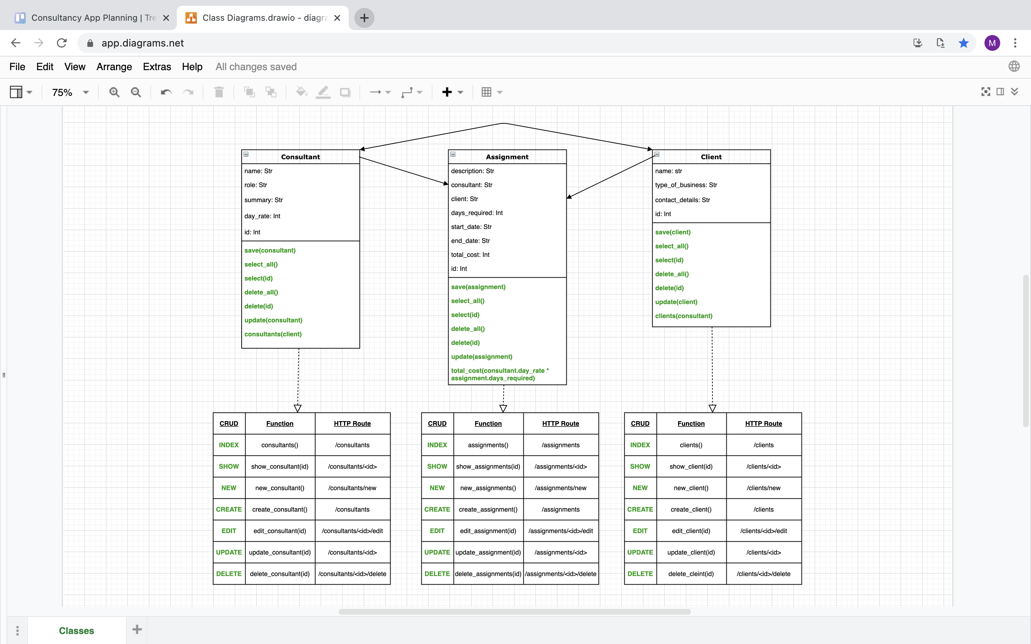
Development - Class Diagrams

Slide 8
Development - Class Diagrams

Slide 9
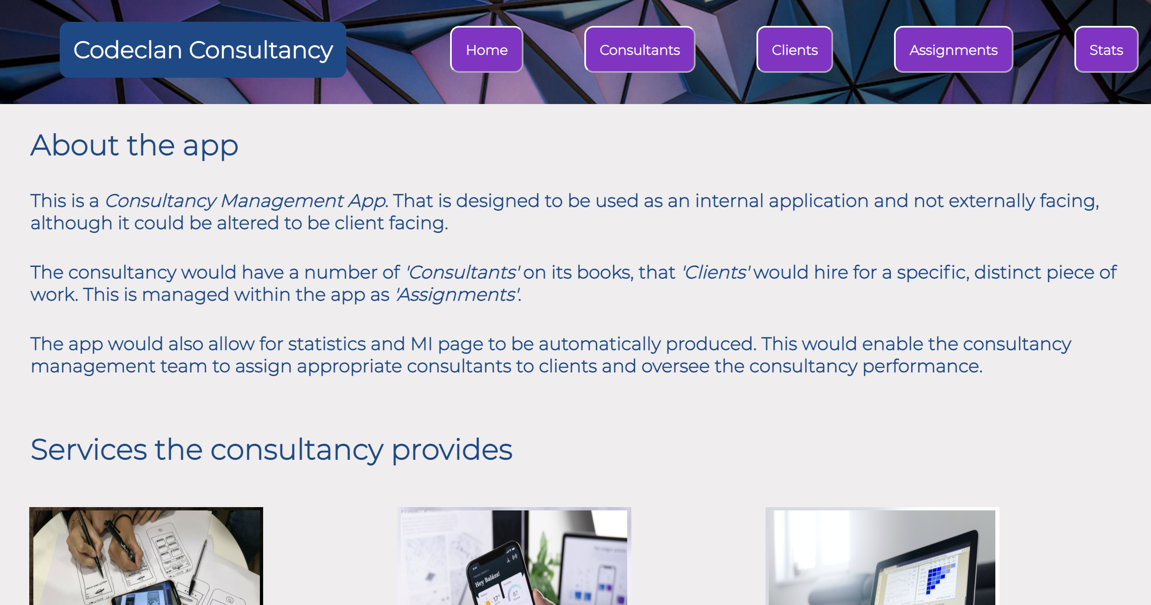
Demonstration

Slide 10
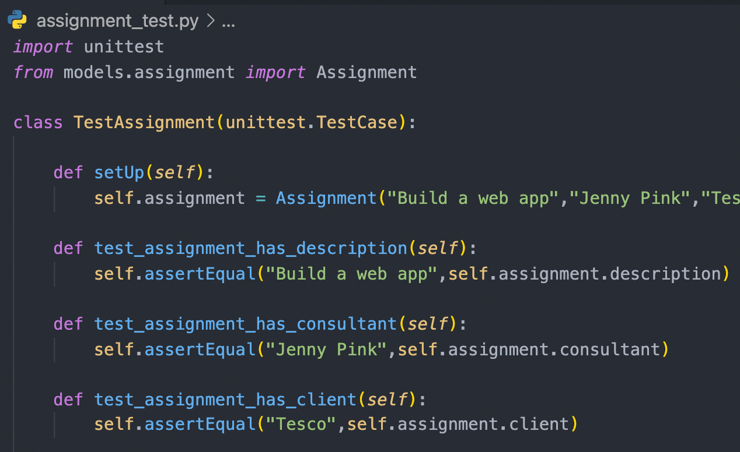
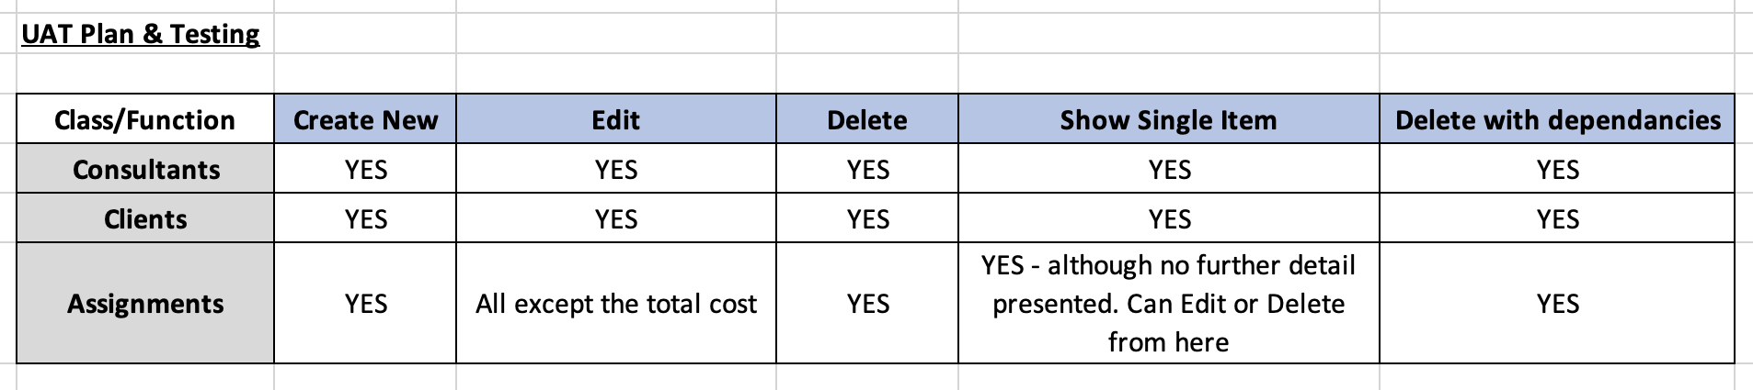
Testing
Test Driven Development
User Acceptance Testing

Slide 11
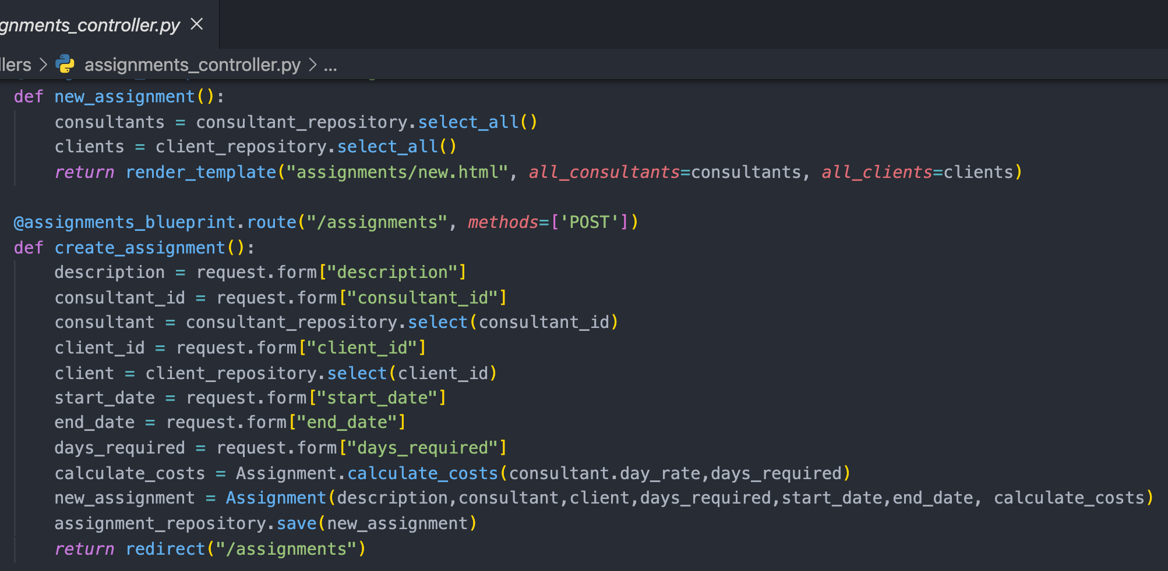
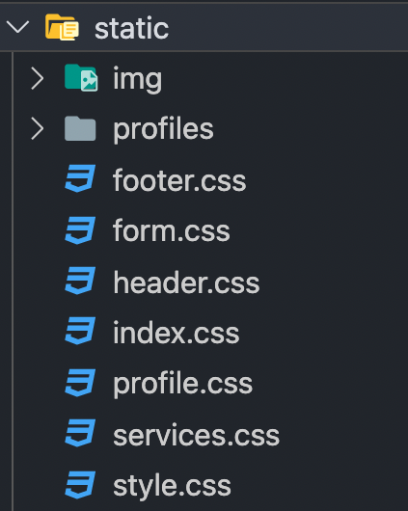
Code
Code I’m proud of…

Slide 12
Learning Points
Planning
Class structure and wireframes are important
However, these are fluid and will alter as you start coding
Testing
Work out which type of testing is best suited to prove your app
TDD – code function testing (less useful for brief)
UAT – user journeys and use cases (more useful for brief)
Styling
Takes a while, keep it simple and work out exactly where styling needs to be
Scope
Keep to the MVP brief, then focus on extensions
Work out your focus and know when to stop

